Slide 1
CCGC 5004 Database Systems
How to Create tables

Slide 2
Objectives
Applied
Given the design for a database, write the DDL statements to create the tables, constraints, and indexes that are required.
Write a script that includes all the DDL statements for creating the tables of a database.
Use MySQL Workbench to work with the columns, data, constraints, and indexes for a table.

Slide 3
Objectives
Knowledge
Describe how each of these types of constraints restricts the values that can be stored in a table: not null, unique, primary key, and foreign key.
Describe the difference between a column-level constraint and a table-level constraint.
Describe the use of an index.
Describe two storage engines that are commonly used with MySQL and the pros and cons of each engine.
Define the various data types that are available when you define a column in a table
DDL is an acronym for Data Definition Language

Slide 4
How to use the CREATE DATABASE Statement
Syntax
CREATE DATABASE [IF NOT EXISTS] db_name

Slide 5
CREATE DATABASE
Before you can begin creating the tables of a database, you must create the database
You may have multiple database running in a single MySQL server
You need to select the database before you begin working with it
If you no longer need the database you can drop it
This will cause all tables and data to be deleted
Typically in a large database project tables will be created by the DBA or a database design specialist
Small installs the SQL developer can also be the acting DBA
In a project the SQL Programmer may still need to create tables for testing
In our case it is the USE N012345678F22 statement
Our setup does not permit you to create additional databases or schemas

Slide 6
CREATE DATABASE
These commands could be used to create a database or schema called AP:
CREATE DATABASE ap; or CREATE SCHEMA ap;
You can also use the option to check if the database or schema already exists:
CREATE DATABASE IF NOT EXISTS ap
You can drop a database or schema named AP
DROP DATABASE ap
You can drop a database after you check if it exists
DROP DATABASE IF EXISTS ap
To use an existing database called AP
USE ap

Slide 7
The Syntax of the CREATE TABLE
CREATE TABLE [db_name.]table_name
(
column_name_1 data_type [column_attributes]
[, column_name_2 data_type [column_attributes]]...
[, table_level_constraints]
As you may observe there are several options to the CREATE TABLE syntax
Notice the db_name in the syntax is in square brackets, it does not need to be coded if you are in the schema already

Slide 8
Data Types in MySQL
A column’s data type specifies the kind of information the column is intended to store
A column’s data type also determines the operations that can be performed on the column
MySQL divides data types into 5 categories

Slide 9
Data Types
Category | Description
Character | Strings of character data
Numeric | Numbers that do not include a decimal point (integers) and numbers that include a decimal point (real numbers)
Date and Time | Dates, times or both
Large Object (LOB) | Large strings of character or binary data, useful for storing images, sound, videoand large text amount
Spatial | Geographical values (GPS) data
JSON | JSON documents (JavaScript Object Notation)
The ones in red are the most common data types

Slide 10
Character Types
Type | Bytes | Description
CHAR(M) | Mx4 | Fixed-length strings of character data where M is the number of characters between 0 and 255, with the ut8mb4 character set. MySQL must reserve 4 bytes for each character in a CHAR column because that is the maximum possible length. Default for MySQL 8.0, typically uses 1 byte per character but can use 4 bytes per character
VARCHAR(M) | L+1 | Variable-length strings of character data where M is he maximum number of characters, between 0 ad 255. For English and Latin characters, the number of bytes used to store the string is equal to the length of the string (L) plus 1 byte to record its length.

Slide 11
Character Types
Data Type | Original Value | Value Stored | Byte Used
CHAR(2) | ‘CA’ | ‘CA’ | 8
CHAR(10) | ‘CA’ | ‘CA’ | 40
VARCHAR(10) | ‘CA’ | ‘CA’ | 3
VARCHAR(20) | ‘California’ | ‘California’ | 11
VARCHAR(20) | ‘New York’ | ‘New York’ | 9
VARCHAR(20) | “Humber’s MySQL” | “Humber’s MySQL” | 15

Slide 12
Integer Types
Type | Bytes | Value Ranges
BIGINT | 8 | -9,223,372,036,854,775,808 to 9,223,372,036,854,775,807 Unsigned 0 to 18,446,744,073,709,551,615
INT | 4 | -2,147,483,648 to 2,147,483,647 Unsigned 0 to 4,294,967,295
MEDIUMINT | 3 | -8,388,608 to 8,388,607 Unsigned 0 to 16,777,215
SMALLINT | 2 | -32,768 to 32,767 Unsigned 0 to 65,535
TINYINT | 1 | -128 to 127 Unsigned 0 to 255
INT is the most commonly used integer data type

Slide 13
How the Integer Types Work
Data Type | Original Value | Value Stored | Value Displayed
INT | 99 | 99 | 99
INT | -99 | -99 | -99
INT UNSIGNED | 99 | 99 | 99
INT UNSIGNED | -99 | None | None
INT ZEROFILLED | 99 | 99 | 0000000099
INT(4) ZEROFILLED | 99 | 99 | 0099

Slide 14
Integer Types
BOOL or BOOLEAN are synonyms of TINYINT(1) used for True or False
INT is the most used since it uses 4 bytes and can store a wide range

Slide 15
Fixed-Point Type
Type | Bytes | Description
DECIMAL (M, D) | Varies | Fixed-precision numbers where M specifies the maximum number of total digits (the precision) and D specifies the number of digits on the right-side of the decimal point (the scale) M can be 1 to 65, D can be 0 to 30, but cannot be larger than M, the default is 0

Slide 16
Floating-Point Types
Type | Bytes | Description
DOUBLE | 8 | Double-precision floating-point numbers from -1.7976*10 308 to 1.7976*10 308
FLOAT | 4 | Single-precision floating-point numbers from -3.4028*10 38 to -3.4028*10 38

Slide 17
How the Fixed-Point and Floating-Point Types Work
Data Type | Original Value | Value Stored | Bytes Used
DECIMAL(9,2) | 1.2 | 1.2 | 5
DECIMAL(9,2) | 1234567.89 | 1234567.89 | 5
DECIMAL(9,2) | -1234567.89 | -1234567.89 | 5
DECIMAL(18,9) | 1234567.89 | 1234567.890000000 | 8
DOUBLE | 1234567.89 | 1234567.89 | 8
FLOAT | 1234567.89 | 1234570 | 4

Slide 18
How to Work with Tables
This will cover how to code the DDL statements that work with the tables of a database
The CREATE TABLE command will create a table in the current database
You can also qualify the table name to have the table created in a different database
CREATE TABLE ex.vendors
This would create a table in the EX database

Slide 19
Common Column Attributes
Attribute | Description
NOT NULL | Indicates that the column does not accept null values, if omitted the column will accept null values
UNIQUE | Specifies that each valued stored in the column must be unique
DEFAULT default_value | Specifies a default value for the column as a literal or as an expression
AUTO_INCREMENT | Identifies a column whose value is automatically incremented by MySQL when a new row is added. An auto increment must be defined as an integer or a floating-point number

Slide 20
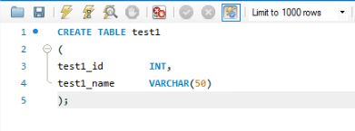
Create Table
CREATE TABLE statement to create a table with no column attributes
First column defines as an INT data type
Second column is variable character data with a length of 50

Slide 21
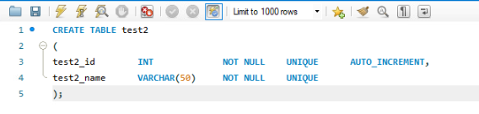
Create Table
Create a table with column attributes
First column defined as NOT NULL UNIQUE with AUTO_INCREMENT
Second column also NOT NULL and UNIQUE

Slide 22
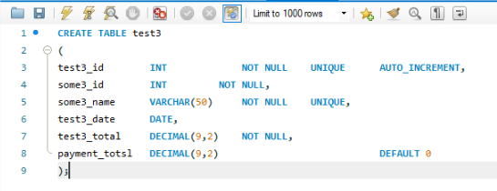
Create Table
Another statement that creates a table with column attributes

Slide 23
Create Table
CREATE TABLE followed by the name of the table
The column list is contained inside a set of parentheses
A comma is placed at the end of each column in the list
(
vendor_id INT,
vendor_name VARCHAR(50)
)

Slide 24
Syntax for PRIMARY KEY Constraint
The syntax of a column-level primary key constraint
column_name data_type PRIMARY KEY column_attributes
A table with column-level constraints
CREATE TABLE vendors
(
vendor_id INT PRIMARY KEY AUTO_INCREMENT,
vendor_name VARCHAR(50) NOT NULL UNIQUE

Slide 25
Code a Primary Key Constraint
NOT NULL and UNIQUE keywords are examples of constraints
A constraint restricts the type of data that can be stored in a column
A NOT NULL keyword prevents null values rom being stored ins column
The UNIQUE keyword only allows unique values
Next, we will look at another type of constraint known as a PRIMARY KEY constraint
A PRIMARY KEY, when it is coded two of the column’s attributes are changed automatically
First the column is forced to be NOT NULL
Second the column is forced to contains unique value for each row

Slide 26
Code a Primary Key Constraint
When you code a constraint in a column level definition it is know as a column-level constraint
You can also define a constraint at the table level using the CONSTRAINT keyword
When you code a table-level constraint you can also provide a name for the constraint
We will look at some examples

Slide 27
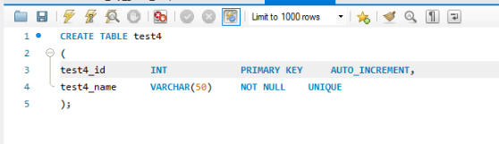
Primary Key Constraint
This is a PRIMARY KEY constraint defined at the column-level

Slide 28
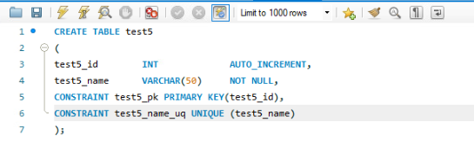
Primary Key Constraint
Here the PRIMARY KEY is coded at the table level
The keyword CONSTRAINT keyword allows a user-defined name to be provided
The constraint name can be either the table name or the column that is used as the constraint
In both cases they use a two-letter suffix to indicate the type of constraint
In both cases the name of the column is given to show the column the constraint is created for
Although you cannot name them at the column level, they work the same regardless where they are coded

Slide 29
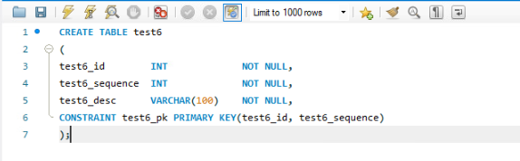
Primary Key Constraint
If you require a composite PRIMARY KEY, it can only be coded at the table level
The columns that make up the composite key are in parentheses and the values are separated by a comma

Slide 30
Primary Key Constraint
Constraints are used to enforce integrity of the data in a table by defining rules about the values that can be stored in columns of the table
You code a column-level constraint as part of the definition of the column it constrains
You code a table-level constraint as if it is a separate column definition and you name the columns it constrains within that definition
A primary key constraint requires that each row has a unique value for the column or columns for the primary key, and it does not allow null values

Slide 31
Coding a FOREIGN KEY Constraint
A foreign key constraint is also known as a reference constraint
This type of constraint is used to define the relationship between tables to enforce referential integrity
MySQL only enforces these constraints if you are using the InnoDB storage engine for your tables
If you are using another storage engine such as MyISAM, you can still code foreign key constraints to show the relationships between the tables, but MySQL does not enforce these relationships
We will discuss storage engines later in this lecture

Slide 32
Foreign Key Syntax
The syntax of a column-level foreign key constraint
[CONSTRAINT] REFERENCES table_name (column_name)
[ON DELETE {CASCADE|SET NULL}]

Slide 33
Foreign Key Syntax
[CONSTRAINT constraint_name]
FOREIGN KEY (column_name_1[, column_name_2]...)
REFERENCES table_name (column_name_1
[, column_name_2]...)
[ON DELETE {CASCADE|SET NULL}]

Slide 34
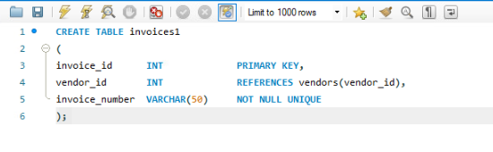
Foreign Key Constraint
This example creates a table with a vendor_id column that includes a REFERENCES clause that identifies the vendor_id column in the VENDORS table as the related column

Slide 35
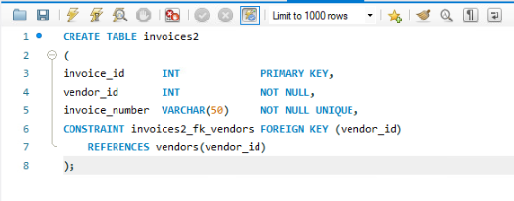
Foreign Key Constraint
In this example the same constraint is coded, instead it is coded at the table level
With this syntax you code the CONSTRAINT keyword followed by a name
Although it is more code it permits you to provide a name for the foreign key constraint
It is good programming practice to name the constraints
Will also permit a foreign key that consists of multiple columns

Slide 36
An INSERT Statement That Fails
INSERT INTO invoices
VALUES (1, 1, '1’)
Response from the system
Error Code: 1452. Cannot add or update a child row: a foreign key constraint fails ('ex'.'invoices', CONSTRAINT 'invoices_fk_vendors' FOREIGN KEY ('vendor_id') REFERENCES 'vendors' ('vendor_id'))

Slide 37
Alter Columns of a Table Syntax
ALTER TABLE [db_name.]table_name
{
ADD column_name data_type [column_attributes] |
DROP COLUMN column_name |
MODIFY column_name data_type [column_attributes] |
RENAME COLUMN old_column_name TO new_column_name
}

Slide 38

Alter Columns of a Table
A statement that adds a new column to a table

Slide 39

Alter Columns of a Table
A statement that drops the column that was just added

Slide 40

Alter Columns of a Table
A statement that changes the length of a column

Slide 41

Alter Columns of a Table
A statement that changes the data type of a column

Slide 42

Alter Columns of a Table
A statement that changes the default value of a column

Slide 43

Alter Columns of a Table
A statement that changes the name of a column

Slide 44

Alter Columns of a Table
This statement will fail
Will not permit the column to be resized if there are values stored that are longer the new length
Will not allow data to be lost

Slide 45
Alter Columns of a Table
You should never alter a table or other database object in a production database without first consulting the DBA

Slide 46
Alter the Constraints of a Table
Syntax
ALTER TABLE [dbname.]table_name
{
ADD PRIMARY KEY constraint_definition |
ADD [CONSTRAINT constraint_name]
FOREIGN KEY constraint_definition |
DROP PRIMARY KEY |
DROP FOREIGN KEY constraint_name
}

Slide 47

Alter the Constraints of a Table
A statement to add a primary key constraint after the table has been created

Slide 48

Alter the Constraints of a Table
You may add a primary key constraint with a name after the tale has been created

Slide 49
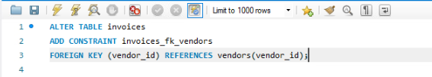
Alter the Constraints of a Table
Statement that adds a foreign key constraint to a table

Slide 50

Alter the Constraints of a Table
Statement to drop the primary key
This may not work
If there is a foreign key connected to the primary key column it will not permit you to drop
It will not permit you to orphan child records
Do not have to provide the column name since a table can only contain one primary key

Slide 51

Alter the Constraints of a Table
Since a table may contain more than one foreign key you need to provide the constraint name

Slide 52
Rename, Truncate or Drop a Table
These statements are not used frequently
Be careful if you are working with or against a production database

Slide 53

Rename, Truncate or Drop a Table
You can rename a table using this command
Have to be aware that it will affect any constraints that use to point to and use the table name
May have to drop constraints and create them again

Slide 54

Rename, Truncate or Drop a Table
This command drops the contents or rows of a table but leaves the column definitions intact
It will only remove all the rows, not like DELETE where you drop certain rows based on criteria

Slide 55

Rename, Truncate or Drop a Table
Will delete all the data from the table and remove table definition
This will include any constraints on the table
If your table has any foreign keys definitions attached to it, you will not be able to drop the table
MySQL will check to see if any other tables depend on the table you are trying to delete
If the table contains a primary key used for foreign keys in other related tables it will not permit you to drop the table
If you had any indexes on the table, they would also be removed

Slide 56
Working with Indexes
An INDEX speeds up joins and searches by providing a way for the database management system to go directly to a row number rather than having to search through all the rows until it finds the one you want
By default, MySQL created indexes for primary keys, foreign keys and unique constraints of a table
These are the most obvious choices for indexes
You can create indexes on other columns that re frequently used in search conditions or joins
You will wan to avoid indexes on columns that are updated frequently since this will slow down insert, update, and update operations
The index has to be rebuilt each time, so it is up to date

Slide 57
CREATE INDEX Syntax
CREATE [UNIQUE] INDEX index_name
ON [dbname.]table_name (column_name_1 [ASC|DESC][,
column_name_2 [ASC|DESC]]...)

Slide 58
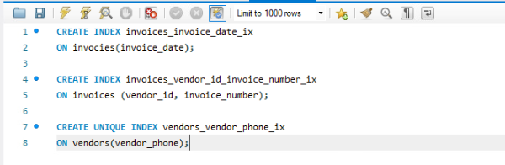
CREATE INDEX Statements
Several CREATE INDEX statements, first on is on single column
Second one is on multiple columns
Third one is a unique index on vendor_phone, this could have been done with a UNIQUE CONSTRAINT

Slide 59

DROP an Index
You can use the DROP INDEX statement to drop an index from a table

Slide 60
Storage Engines
A storage engine determines how MySQL stores data and which database features are available to you
Unlike many other databases, MySQL provides several different engines that you can use
Each of these engines provides slightly different features
The two most popular engines are InnoDB and MyISAM
InnoDB is the default since MySQL 5.5
Prior to MySQL 5.5 it was MyISAM
MyISAM does not support foreign keys, an important feature for referential integrity
You can use multiple storage engines on the same server and within the same database

Slide 61
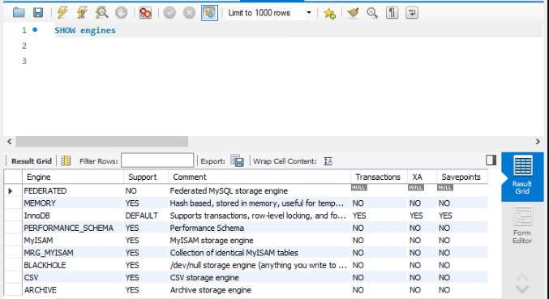
SHOW Engines
The SHOW engines command displays the available engines in MySQL

Slide 62
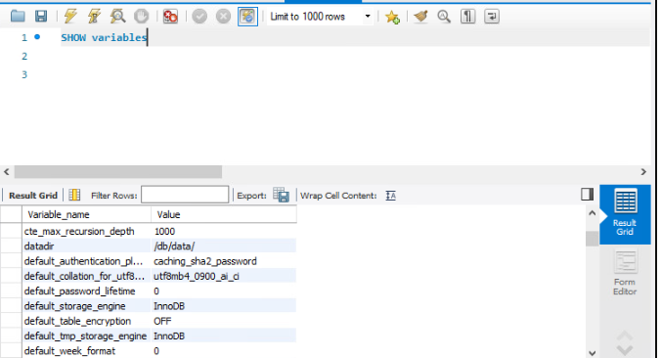
SHOW variables
The SHOW variables displays shows the value of many variables set in MySQL
One of these is the default_storage_engine

Slide 63
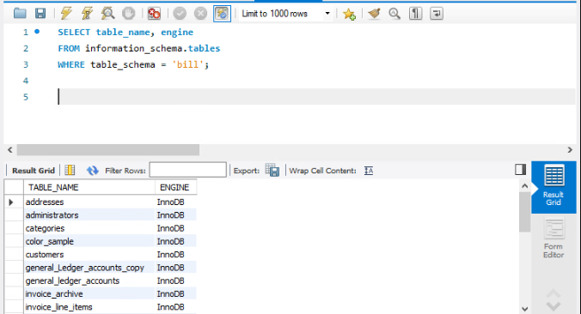
Display Storage Engine for Tables
The above command will display the storage engine used when a table was created

Slide 64
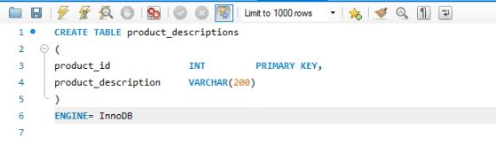
Define a Storage Engine
After the column definitions have been defined you can define the storage engine for the table
I attempted to define it as MyISAM to find out that the MyISAM has been disabled
By default, if you do not declare the storage engine in our version InnoDB is the default that is used
This clause does not need to be coded

